Slide 1
Resources, Marketing, and Tier Structure
BSO President’s Workshop
10/08/2013, BE 108
10/09/2013, Ballroom D
10/25/2013, BE 241

Slide 2
Resources on Campus
Think about what your club needs:
(1) Ask Travis Smith or Jenn Mazzotta
(2) Board of Student Organizations
a) Office hours are on OrgSync
(3) OrgSync pages (trainings upcoming)
(4) Reserving rooms for meetings
a) reservations.mines.edu, for now
b) OrgSync form coming soon

Slide 3
Marketing your Club
Advertising!
(1) Celebration of Mines
(2) Campus-wide mailmans
a) http://ccit.mines.edu/Mailman-Common-Lists
b) [SSA] is used for most things
c) Use to announce events to campus
(3) Flyers in building and Residence Halls
(4) Student Recreation Center marquee
(5) Word-of-mouth

Slide 4
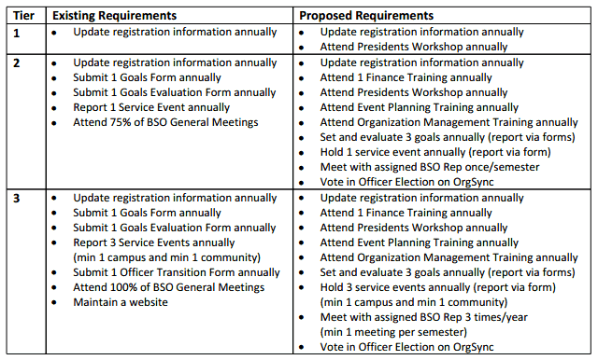
Tier Structure Requirements
New Tier Structure proposal was passed:

Slide 5
Tier Structure Requirements (con’t)
Other Updates:
1. Remember, if you are Tier 1+, 2, 2+, or 3, you should schedule a time to meet with your BSO Exec Rep
2. Goals Forms were due 10/1 - if you have not submitted it yet, please do so SOON!
3. Org Management/Event Trainings - November 4th, 5th, and 6th @ 9 AM, 1 PM, and 5 PM respectively
4. Start doing Service Events!

Slide 6
Questions/Comments/Concerns?

Slide 7
Open Forum

